Slide 1
CREDIT EDA CASE STUDY
By-
Sambit Sekhar Sahu
Joseph Babu

Slide 2
Data Cleaning and Preparation
While working on any data set, the first important step is to clean data and prepare it for further use.
Columns with null value content of greater than 50% were dropped, according to Industry standards.
Suitable data imputation techniques were suggested for columns having null values less than or equal to 13%, i.e., Mean/Median for Numerical Columns & Mode for Categorical Columns.

Slide 3
Then we went on with the data quality checks, where we found Days related column had days in –ve values. So using abs() function –ve values were converted into positive values.
Missing values of the form ‘XNA’ & ‘XNP’ were replaced with python understood NAN values using np.NAN function.
Then we moved ahead with binning of continuous variable – Income & Age columns.

Slide 4
Analysis on Application Data

Slide 5
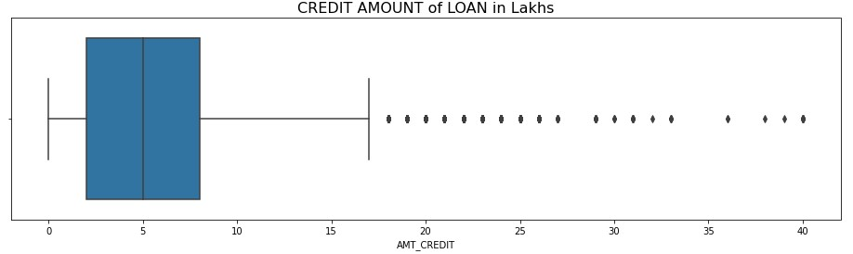
Outlier Analysis of Credit Amount
We observe outliers are present within the range 20-40 Lakhs

Slide 6
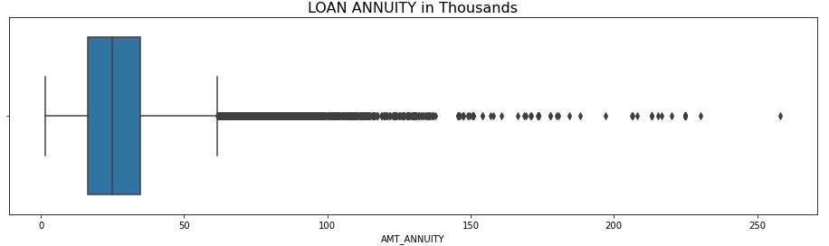
Outlier Analysis of Loan Annuity
We can observe outliers here, >250k being the highest outlier value.

Slide 7
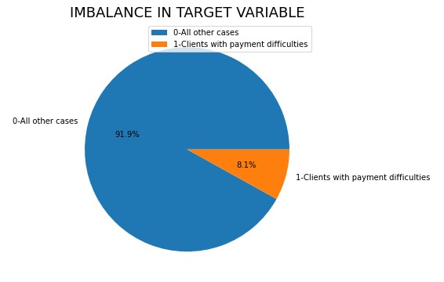
Data Imbalance in Target Variable
We see the data is not equally distributed in TARGET variable between clients with payment difficulties and all other cases

Slide 8
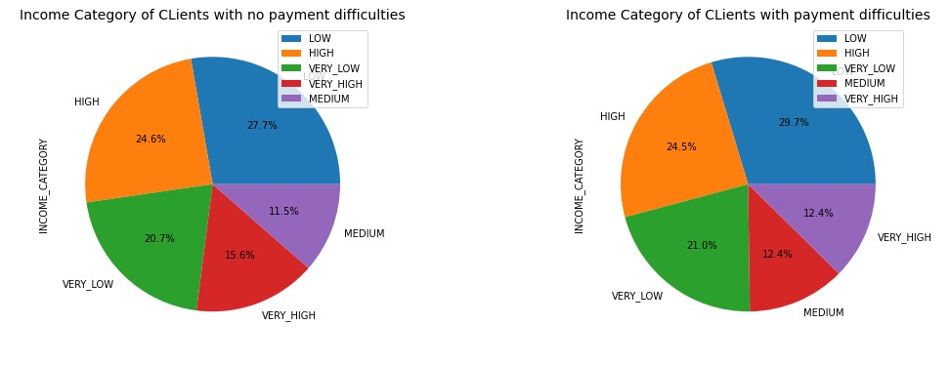
Income CATEOGORY with respect to target variable
For the clinets falling in the low income category, the possibility of dafaulting has an increased by 2%.
While clients falling in the Very High income category, the possibility of defaulting has reduced by 3.2%

Slide 9
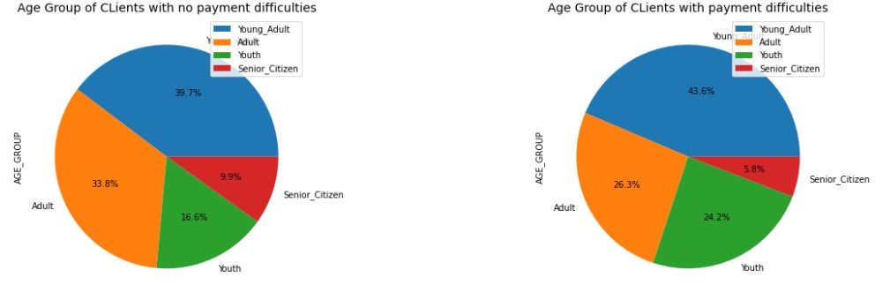
Age Group with respect to target variable
In Young Adults, the possibility of defaulting has an increased by 3.9%.
While in Senior Citizens category, the possibility of defaulting has decreased by 4.1%

Slide 10
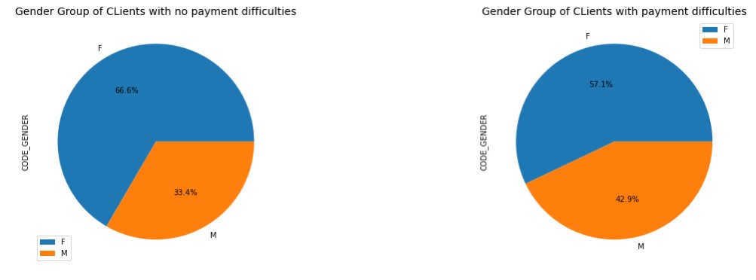
Gender with respect to target variable
In Females the possibility of defaulting has reduced by 9.5%. While on the other hand the possibility of dafaulting has
increased by 9.5%

Slide 11
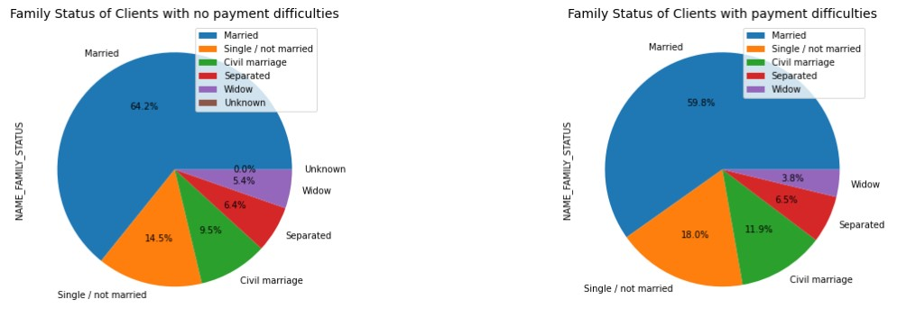
Family Status with respect to target variable
In Married people payment difficulties has reduced by 4.4% & in widow category it has decreased by 1.6%.
While in other categories we can see increase in payment difficulties whith Not Married category being highest at 3.5%

Slide 12
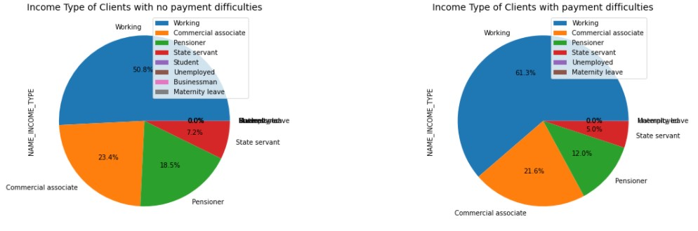
Income Type with respect to target variable
We see payment difficulties has significantly incresed to 10.5% for Working category clients. While in other categories
we see reduction in payment difficulties with 6.5% being highest in the Pensioner Group of clients

Slide 13
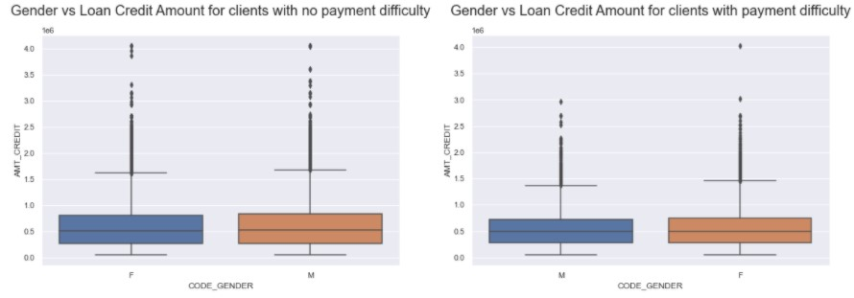
Analysis how Loan Credit amount varies with Gender for both target 0 & 1 type clients
Both genders seems to perform almost equally

Slide 14
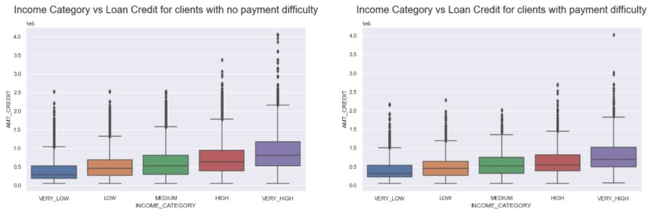
Analysis how Income Category varies with Loan Credit for both target 0 & 1 type clients
The credit amount increases with each increasing income category.

Slide 15
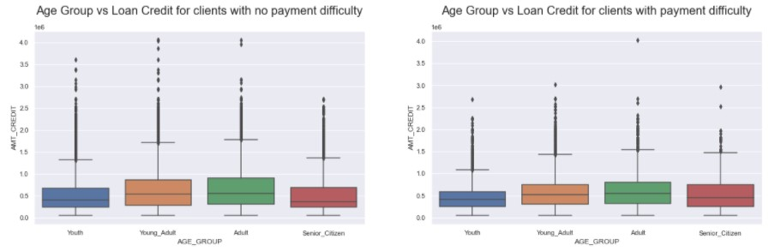
Analysis how Age Group varies with Loan Credit for both target 0 & 1 type clients
In both cases clients falling under Young_Adult age group & Adult age group applied for or have more Loan Credit Amount

Slide 16
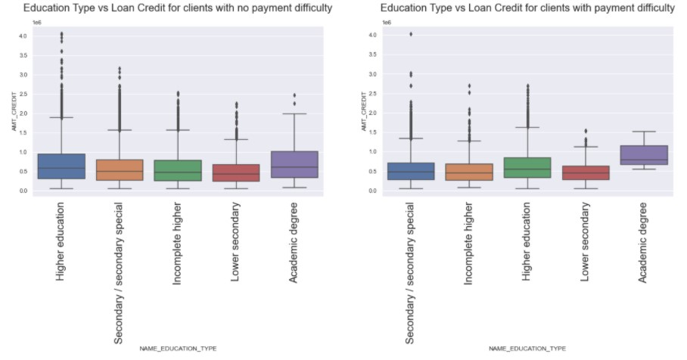
Analysis how Education Type varies with Loan Credit for both target 0 & 1 type clients
In both the graphs Clients with Academic degree & Higher Education are more likely to take loans
And also Academic degree category of clients are most likely to default in loans, followed by higher education category.

Slide 17
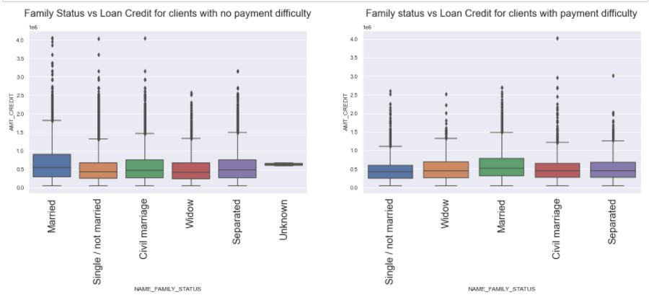
Analysis how Family Status varies with Loan Credit for both target 0 & 1 type clients
We can see that Married Clients are more likely to apply for loans and also most likely to default on loans among the rest

Slide 18
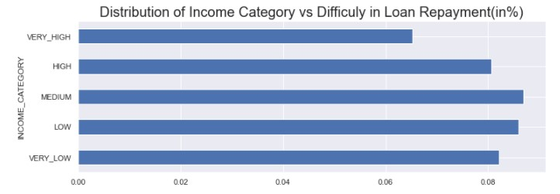
Distribution of Income category with respect to Difficulty in Loan Repayment
We can observe that Medium Income range clients are more likely to default, followed by Low Income range clients

Slide 19
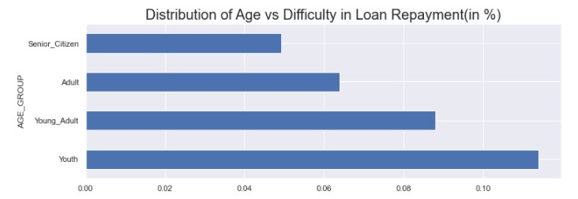
Distribution of Age Group with respect to Difficulty in Loan Repayment
We observe that clients falling in Youth age category is most likely to default, followed by Young Adults

Slide 20
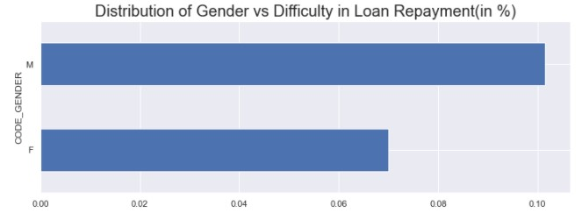
Distribution of Age Group with respect to Difficulty in Loan Repayment
Males are more likely to default on loans rather than Females

Slide 21
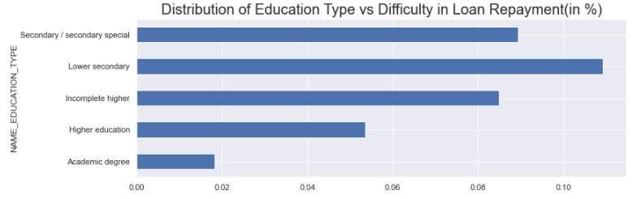
Distribution of Education Type with respect to Difficulty in Loan Repayment
Clients with Lower Secondary Education Type are most likely to default on loans. followed by Secondary Special

Slide 22
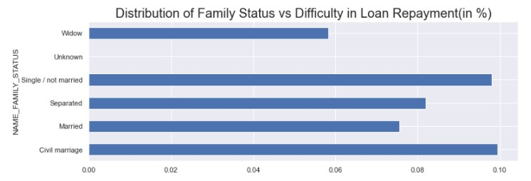
Distribution of Family Status with respect to Difficulty in Loan Repayment
We can see that clients who had civil marriage or are unmarried are almost equally likely to default on loans, followed by Separated

Slide 23
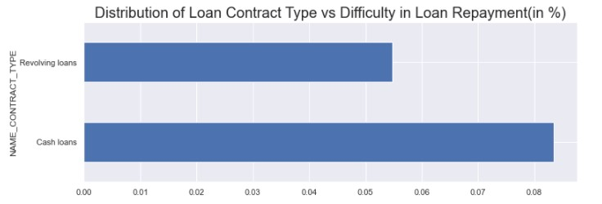
Distribution of Loan Contract Type with respect to Difficulty in Loan Repayment
Clients are more likely to default on Cash Loans rather than Revolving Loans

Slide 24
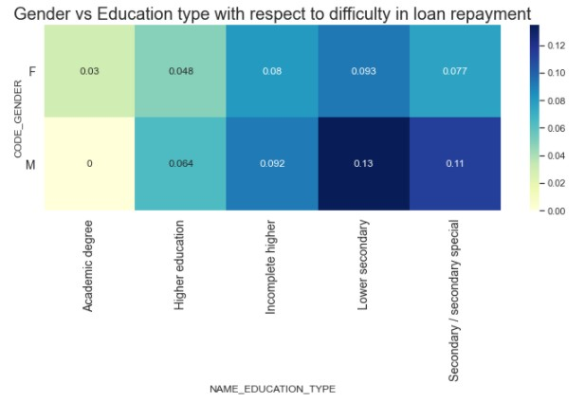
Gender vs Education Type with respect to difficulty in loan repayment
Both Male & Female Clients having Lower Secondary Education are most likely to default on loans

Slide 25
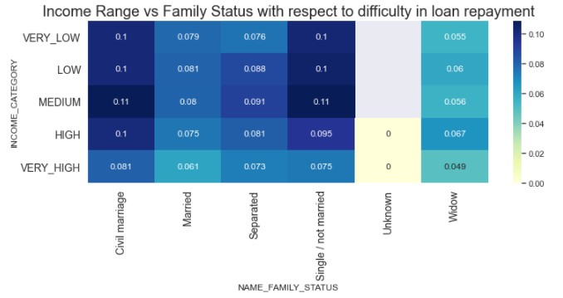
Income Range vs Family Status with respect to difficulty in loan repayment
Clients with Civil Marriage and Single with Income Category as Medium are most likely to default on loans

Slide 26
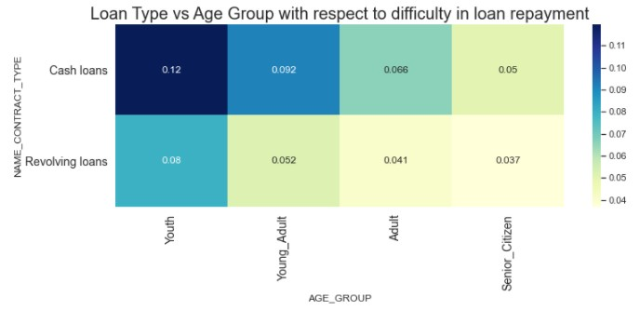
Age group vs Loan Type with respect to difficulty in loan repayment
Clients falling in Youth Age group category & Opting for Cash Loans are most likely to default

Slide 27
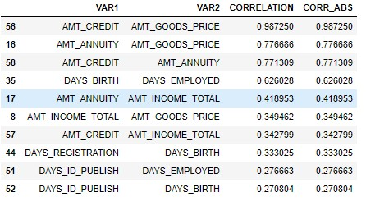
Top 10 Correlation for clients having no repayment difficulties of loan (Target 0)

Slide 28
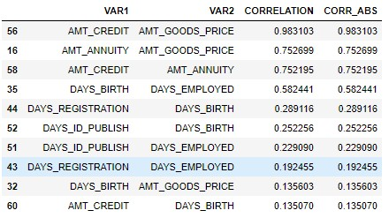
Top 10 Correlation for clients having no repayment difficulties of loan (Target 0)

Slide 29
Insights on Top 10 Correlation Pair
From the above table we can conclude that, for both Target type of clients, the top 4 correlation pair is same.
1.AMT_CREDIT & AMT_GOODS_PRICE
2.AMT_ANNUITY & AMT_GOODS_PRICE
3.AMT_CREDIT & AMT_ANNUITY
4.DAYS_BIRTH & DAYS_EMPLOYED

Slide 30
Analysis on Previous Application Data

Slide 31
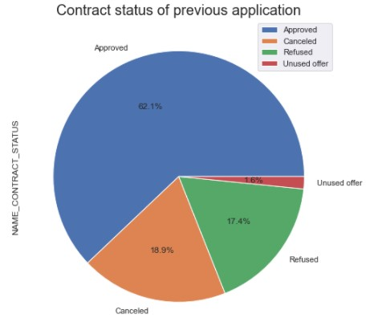
Contract status of previous application
Majority of the loans were approved & a very less percentage of loans were unused

Slide 32
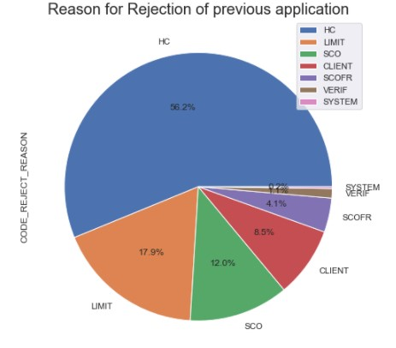
Reason for Rejection of previous application
HC is the reason for which maximum loans were rejected

Slide 33
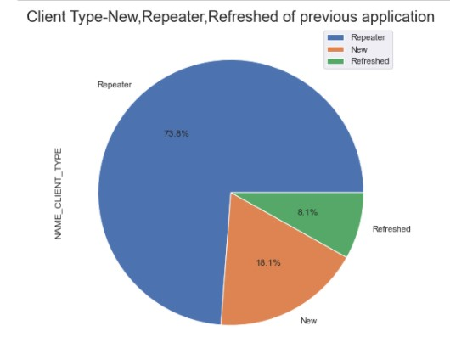
Client Type- New Repeater or Refreshed,of previous application
Majority of the loan appliers are Repeaters or clients who have taken loan previously

Slide 34
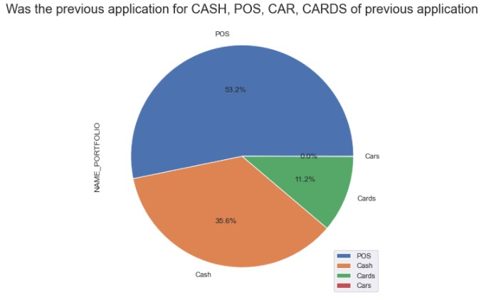
Was the previous application for CASH, POS, CAR, CARDS,of previous application
Majority of the loan application were for POS

Slide 35
Analysis after merging both Application & Previous application

Slide 36
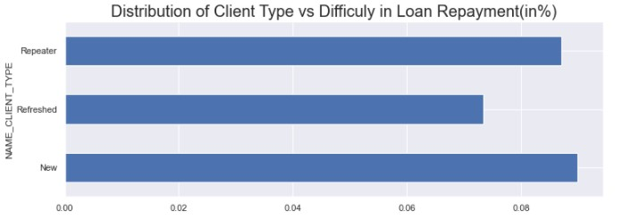
Distribution of Client Type vs Difficulty in Repayment of Loan(in%)
We can see that clients with no previous loan history have most difficulty in loan repayment

Slide 37
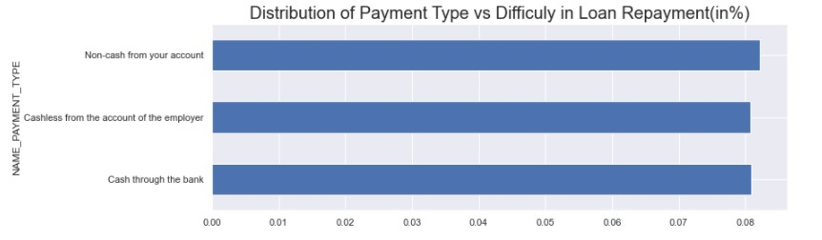
Distribution of Payment Type vs Difficulty in Loan Repayment(in%)
All payment type perform almost similarly with respect to difficulty in loan repayment

Slide 38
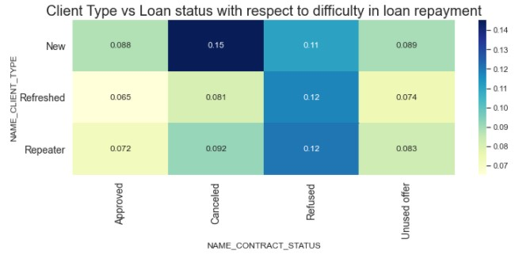
Client Type vs Loan with respect to difficulty in loan repayment
We can observe that New clients, those with no previous loan history and with previous Loan status cancelled have highest loan repayment difficulty

Slide 39
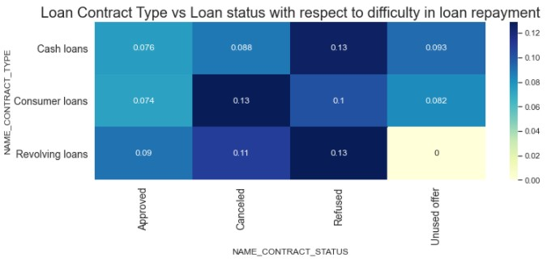
Loan Contract vs Loan with respect to difficulty in loan repayment
Clients with Cash loans & with previous application status as Refused have most loan repayment difficulties.
And the same goes for-
Clients with Consumer loans & with previous application status as Cancelled.
Clients with Revolving loans & with previous application status as Refused.

Slide 40
INSIGHTS- Application Data
Both Male & Female Clients having Lower Secondary Education are most likely to default on loans
Clients with Civil Marriage and Single with Income Category as Medium are most likely to default on loans
Clients falling in Youth Age group category & Opting for Cash Loans are most likely to default
We can see that Low-Skill Laborers are most likely to default on loans
Clients are more likely to default on Cash Loans rather than Revolving Loans
Clients with Lower Secondary Education Type are most likely to default on loans.

Slide 41
INSIGHTS- Previous Application Data
HC of 'CODE_REJECT_REASON' is the reason for which maximum loans were rejected
We can observe that New clients, those with no previous loan history and with previous Loan status cancelled have highest loan repayment difficulty

Slide 42
Other Insights
We also observe outliers in the Credit Amount, which bank should be careful about otherwise it might result of Credit Loss to the bank.

